Slide 1

Large Language Models (LLMs):
Application to Production with Databricks
Author: VINEET SRIVASTAVA (AI Intern)
Supervisor : Antell, Gregory C.,Ph.D. (Principal AI/ML Engineer)
Department: Informatics & Analytics (AIOPS)
Date: 27th July 2023

Slide 2
Contents:
LLM introduction and databricks
Applications with LLMs
Embeddings, Vector Databases and Search
Multi-Stage Reasoning (LLM chains, Prompts, Agents, Langchain)
Fine-Tuning (Traditional fine-tuning, PEFT, Instruct-finetuning, RLHF)
Task-Specific Evaluation (Accuracy, Precision, Recall, Rouge Score, BLEU)
Ethical Evaluation (Risks, Toxicity, Hallucinations, Mitigation)
LLMOPs (MLOPs vs LLMOPs, model loading, Inference pipeline- Delta Tables, MLFLOW, Orchestration using Delta Live Tables)

Slide 3
Introduction to LLMs

Slide 4
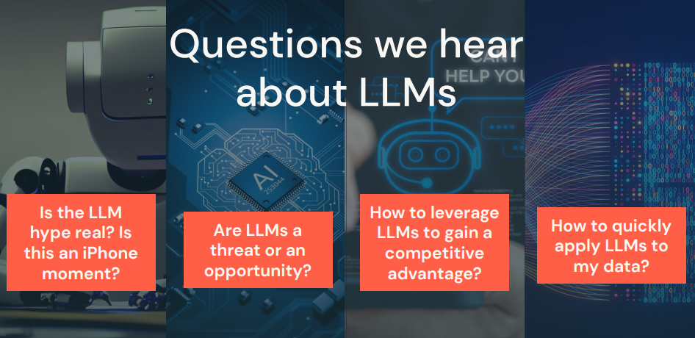

Slide 5



LLMs are more than hype
They are revolutionizing every industry
“Chegg shares drop more than 40% after company says ChatGPT is killing its business”
05/02/2023
Link
“[...] ask GitHub Copilot to explain a piece of code. Bump into an error? Have GitHub Copilot ﬁx it. It’ll even generate unit tests so you can get back to building what’s next.”
03/22/2023*
Link
“[YouChat is an] AI search assistant that you can talk to right in your search results. It stays up-to-date with the news and cites its sources so that you can feel conﬁdent in its answers.”
12/23/2022
Link

Slide 6
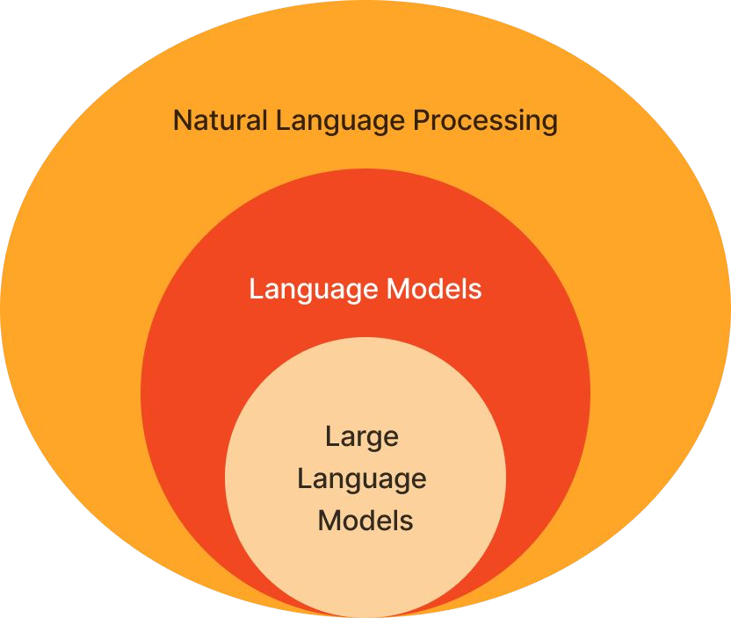
LLMs are not that new
Why should I care now?
Accuracy and effectiveness has hit a tipping point
Many new use cases are unlocked!
Accessible by all.
Readily available data and tooling
Large datasets.
Open-sourced model options.
Requires powerful GPUs but are available on the cloud.

Slide 7
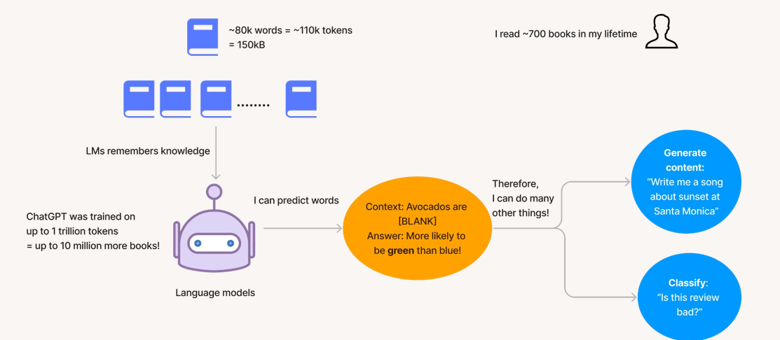
What is an LLM?
It’s a large language model trained on enormous data

Slide 8
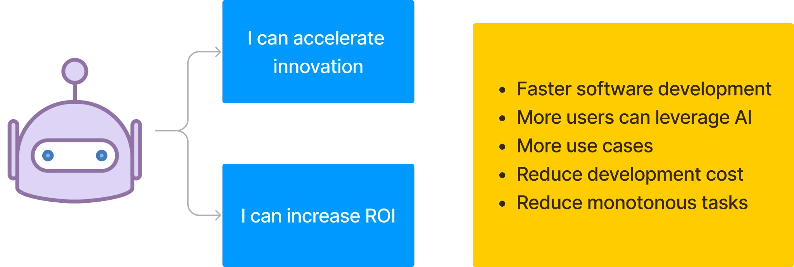
What does that mean for me?
LLMs automate many human-led tasks

Slide 9
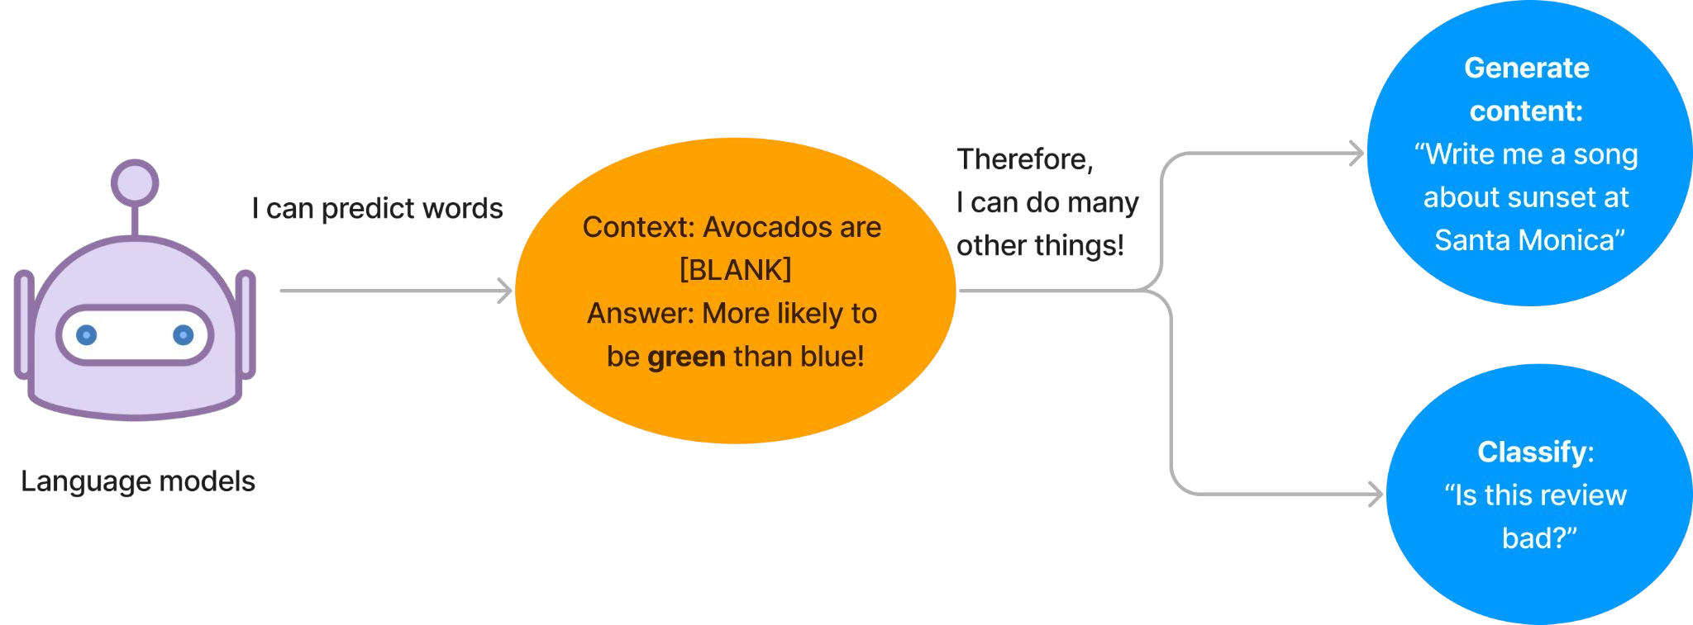
What is a Language Model?
LMs assign probabilities to word sequences: ﬁnd the most likely word
Categories:
Generative: ﬁnd the most likely next word
Classiﬁcation: ﬁnd the most likely classiﬁcation/answer

Slide 10
What is a Large Language Model?

Slide 11
Application with LLMs- Hugging Face & Prompts

Slide 12
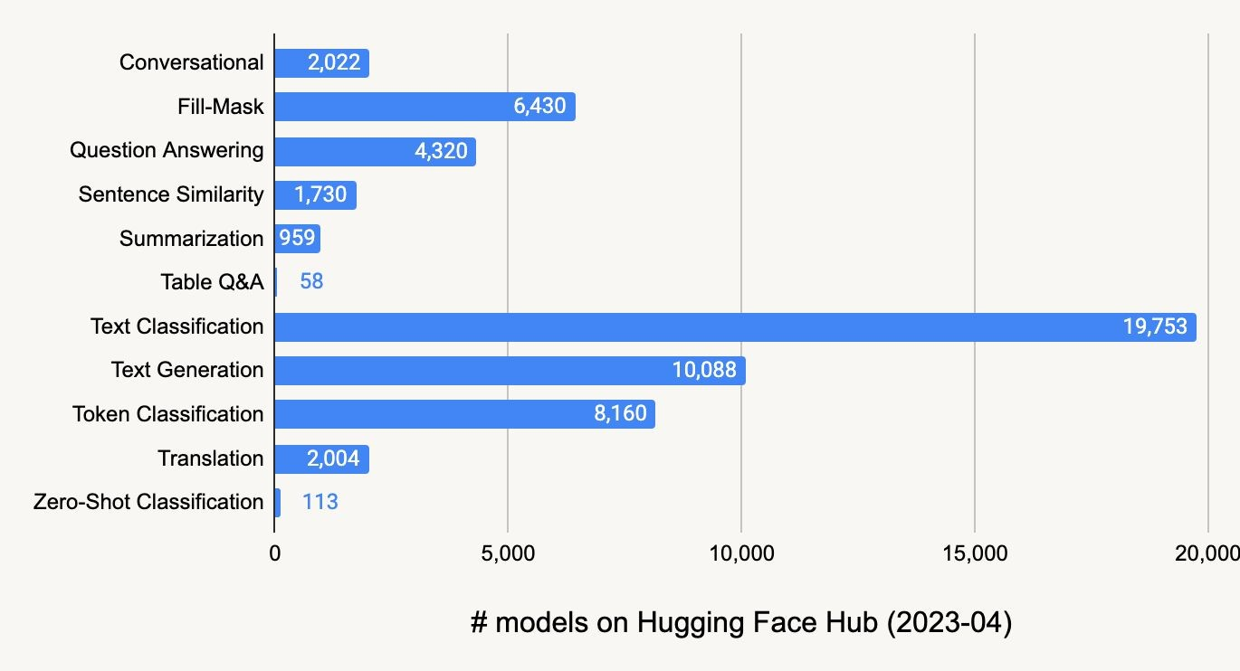
Hugging Face LLMs Types & Counts
Hugging Face Models

Slide 13

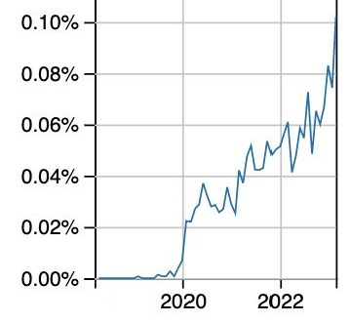
Hugging Face
% of Stack Overﬂow questions that month
Stack Overflow:huggingface-transformers
The Hugging Face Hub hosts:
Models
Datasets
Spaces for demos and code
Key libraries include:
datasets: Download datasets from the hub
transformers: Work with pipelines, tokenizers, models, etc.
evaluate: Compute evaluation metrics
Under the hood, these libraries can use PyTorch, TensorFlow, and JAX.

Slide 14
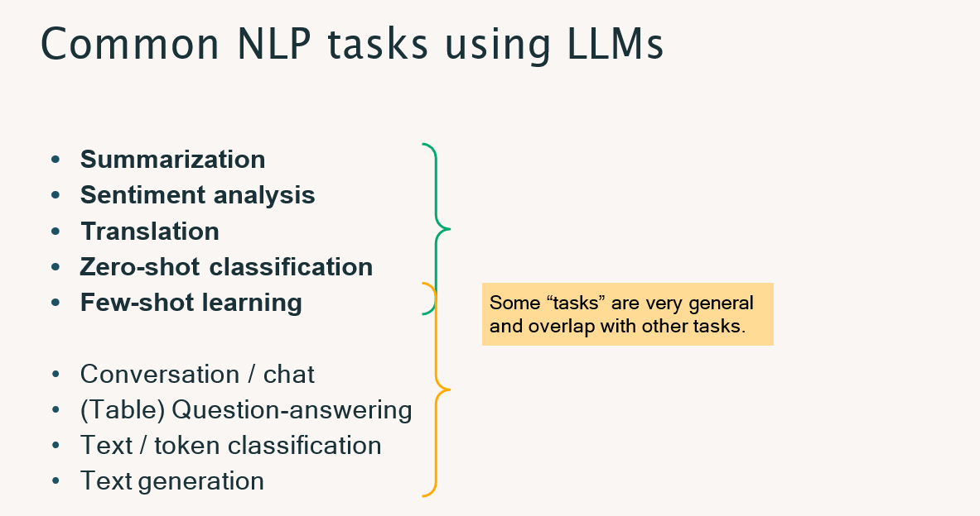
Refer on Databricks: LLM 01 - LLMs with Hugging Face

Slide 15
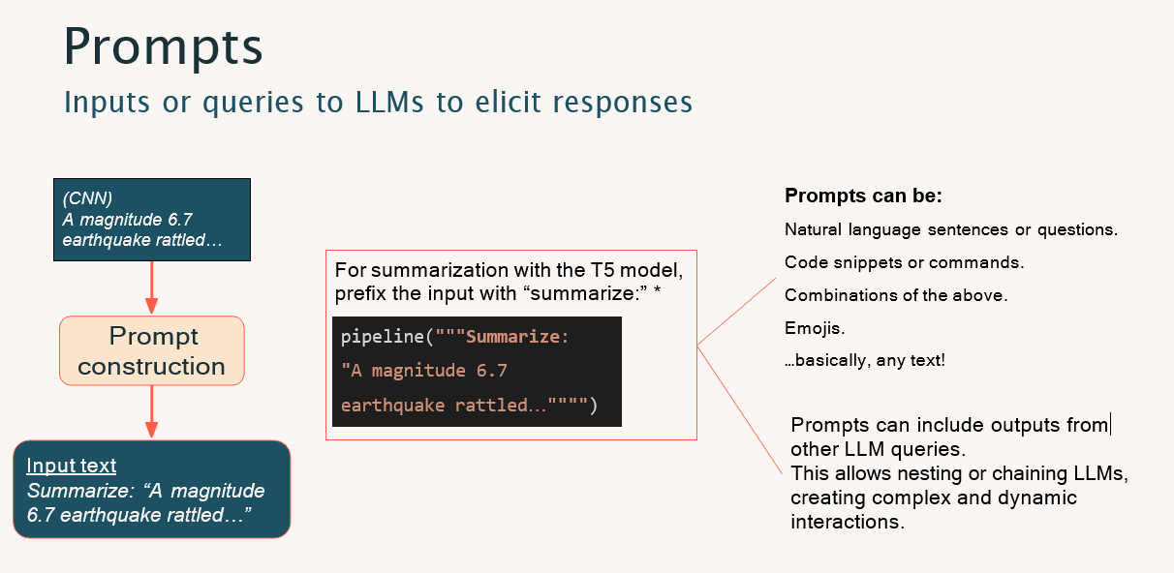

Slide 16
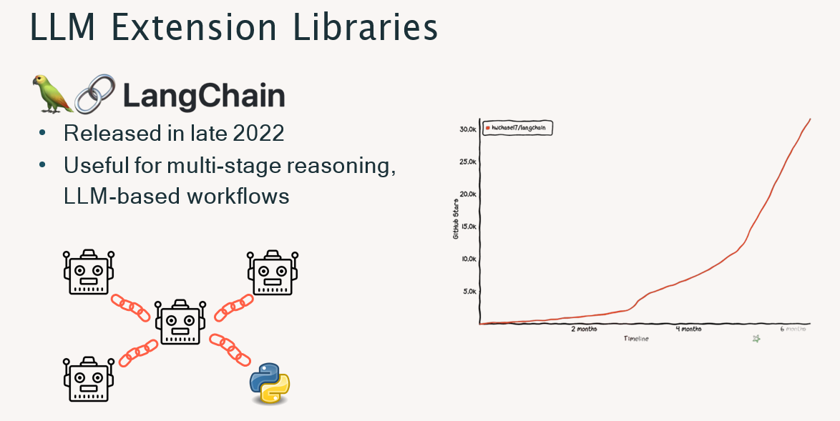

Slide 17
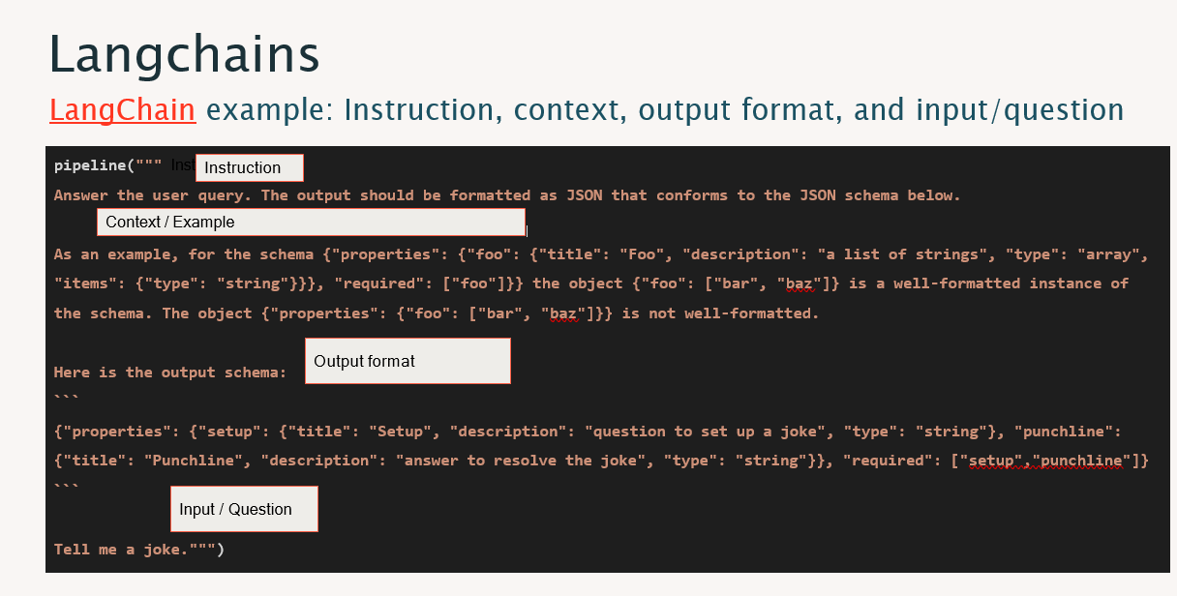

Slide 18
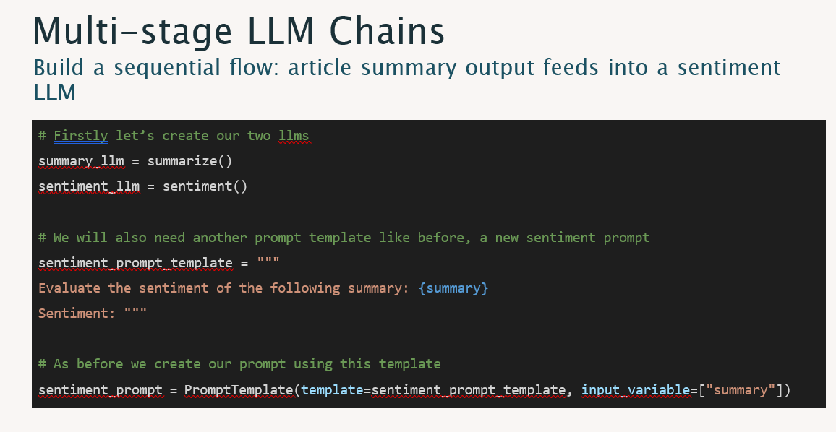

Slide 19
Best practices for OpenAI-speciﬁc models, e.g., GPT-3 and Codex Prompt engineering guide by DAIR.AI
ChatGPT Prompt Engineering Course by OpenAI and DeepLearning.AI Intro to Prompt Engineering Course by Learn Prompting
Tips for Working with LLMs by Brex Tools to help generate starter prompts:
AI Prompt Generator by coefﬁcient.io
PromptExtend
PromptParrot by Replicate
Guides and tools to help writing prompt

Slide 20
Embeddings, Vector Databases & Search

Slide 21
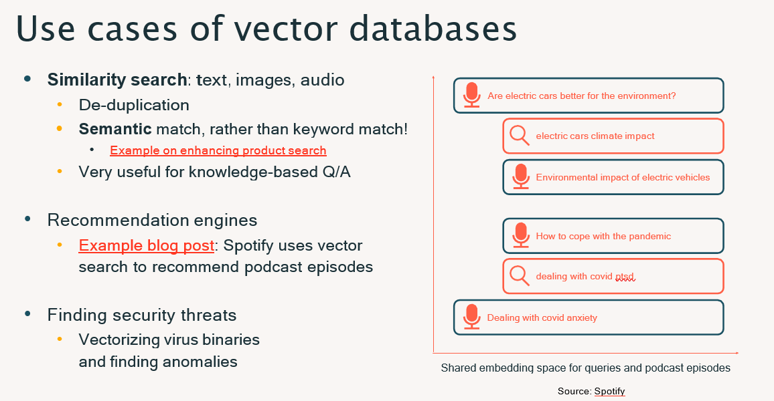

Slide 22
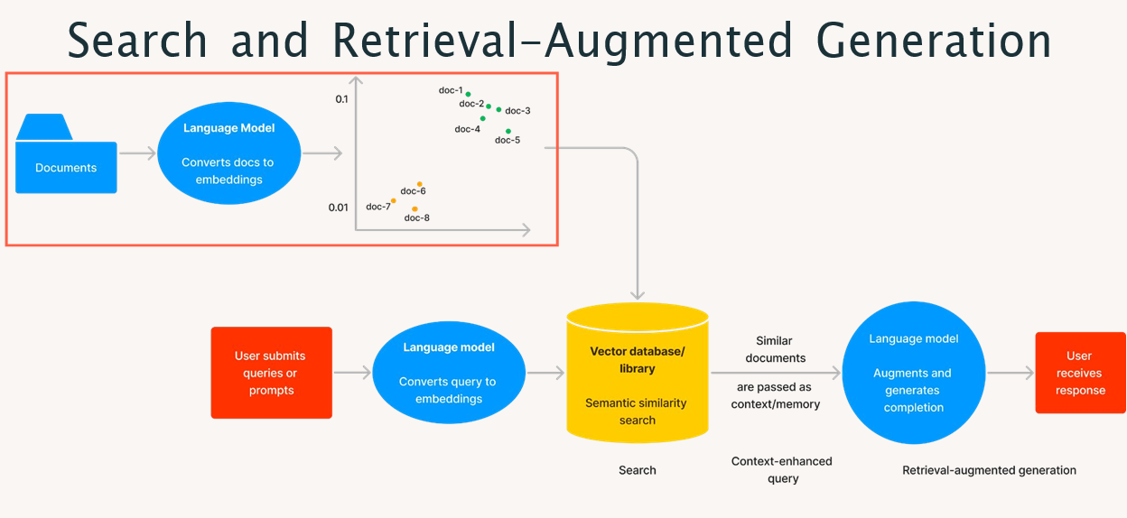
Azure Cognitive Search uses similar workflow

Slide 23
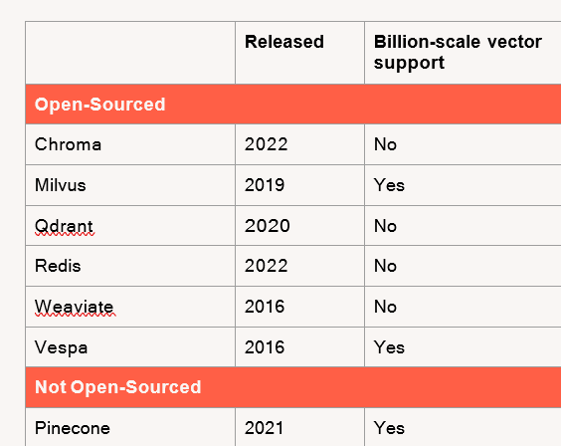
Popular Vector Databases
All of them are integrated with Langchain

Slide 24
Fine-Tuning & Evaluating LLMs

Slide 25
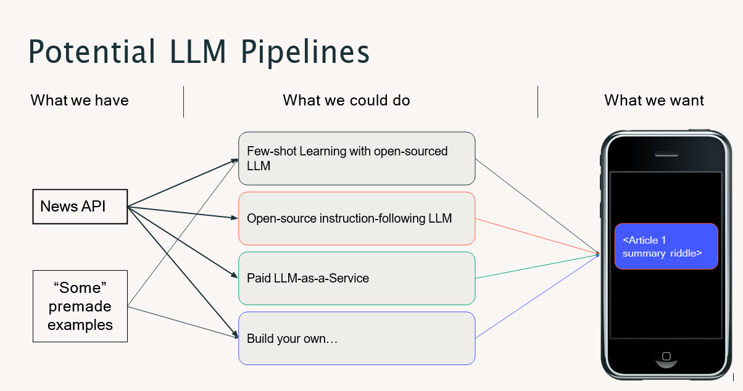

Slide 26
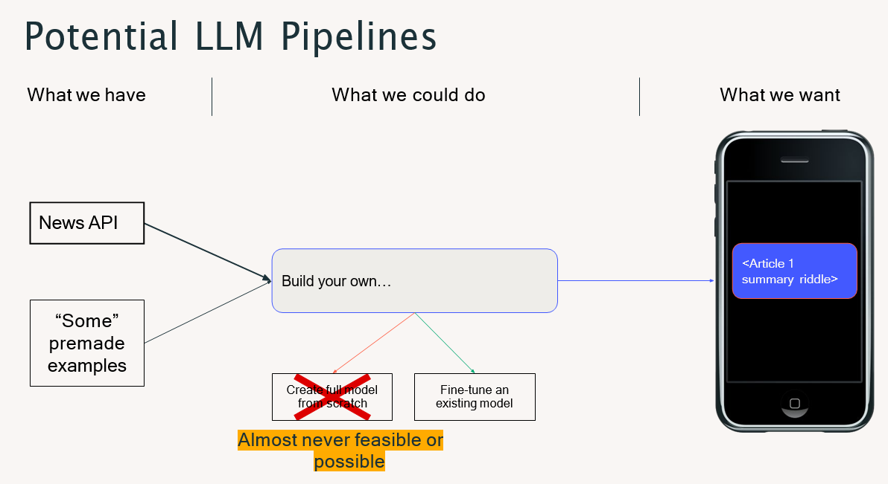

Slide 27
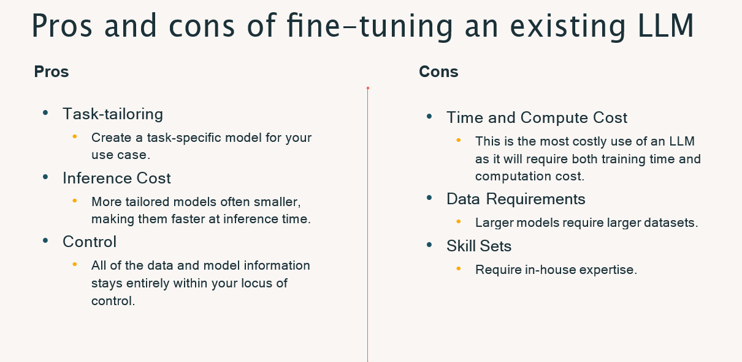

Slide 28
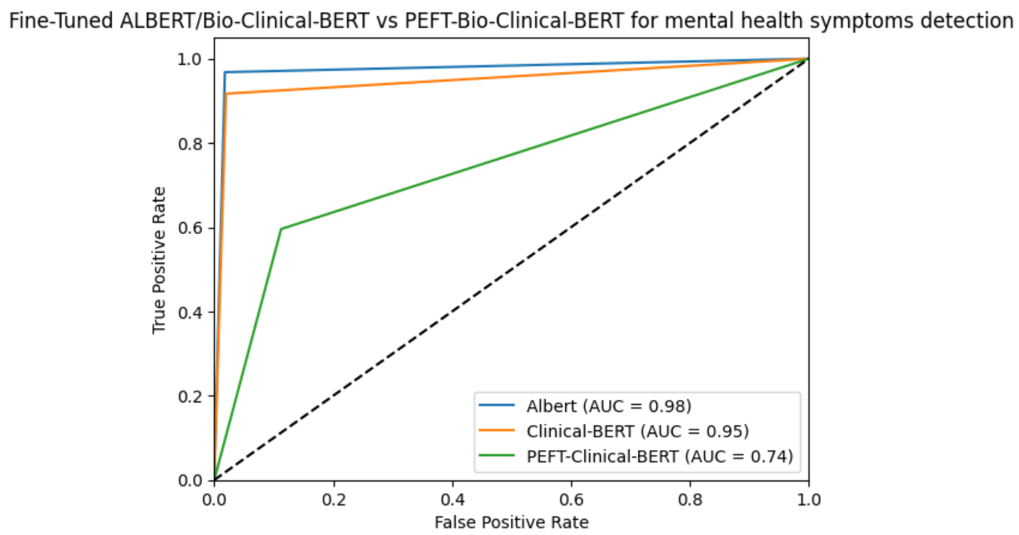
Other Types of Fine-Tuning:
Parameter Efficient Fine-Tuning (PEFT): We freeze the Embeddings/hidden layers weights and only fine-tune the head/output layer, faster to train, cost-friendly but can impact the accuracies of the model.
Reinforcement Learning from Human Feedback (RLHF): E.g. To generate human like responses from a labelled dataset for an already trained/fine-tuned model, takes actions based on rewards.

Slide 29
Refer: Mental Health/Depression Detection Notebooks on Databricks used for DLT Project (fine-tuning pre-trained ALBERT and Bio-Clinical BERT models)

Slide 30
Question is before evaluation where do you store
model weights or how do you load it?
One Option is to create a private repo on Hugging Face Portal Hub and load the model directly in scripts just like other pre-trained/fine-tuned models on Hugging Face Hub using your specific token-key.
Another option is to upload the model artifacts (weights, config files) on Azure blob storage as a zip and pull it in databricks DBFS, unzip and then load from unzipped folder in the script.

Slide 31
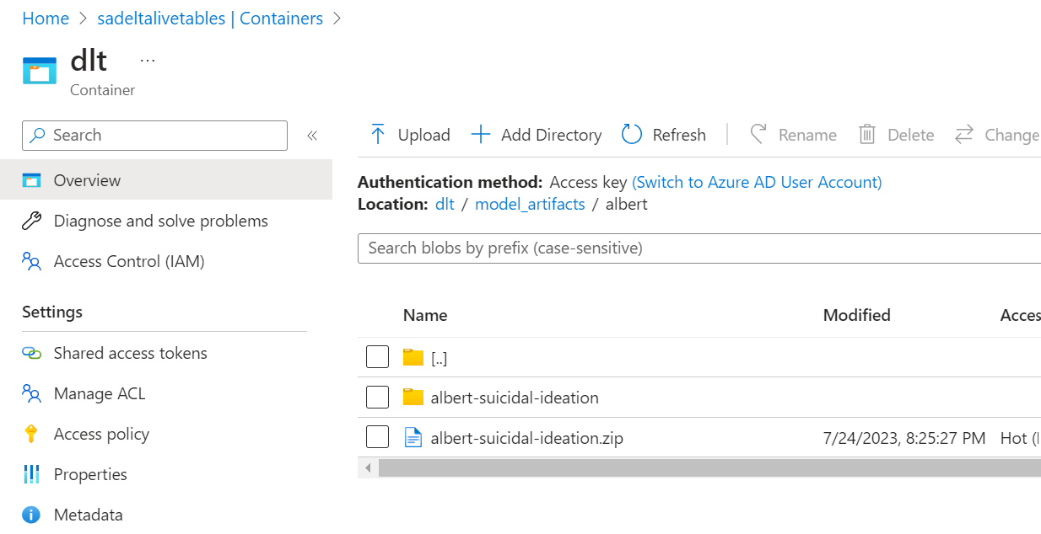
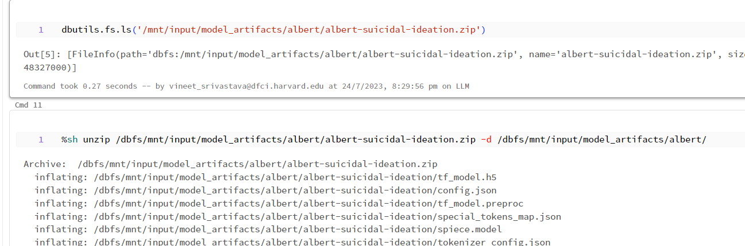
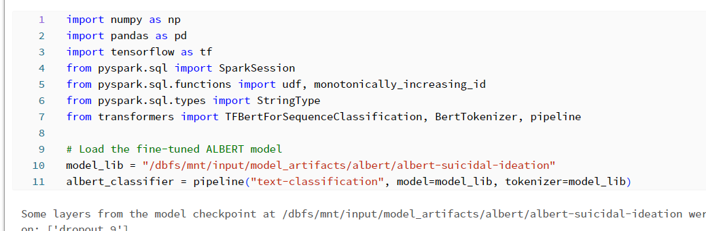
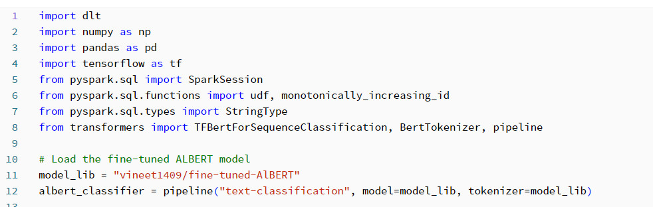
Loading Model Weights and Config files
Azure Storage and Databricks DBFS
From Hugging Face

Slide 32
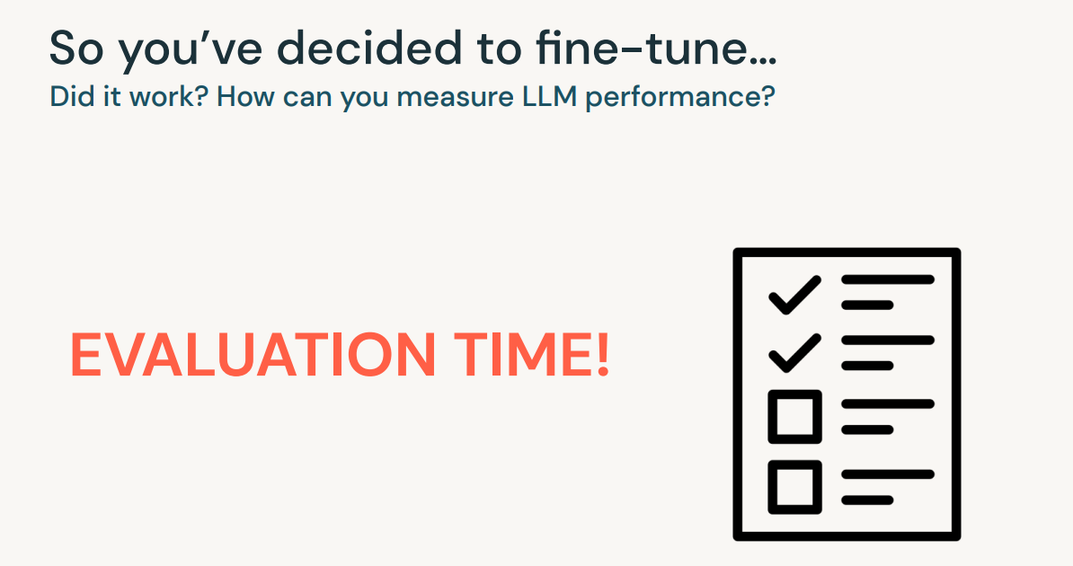

Slide 33
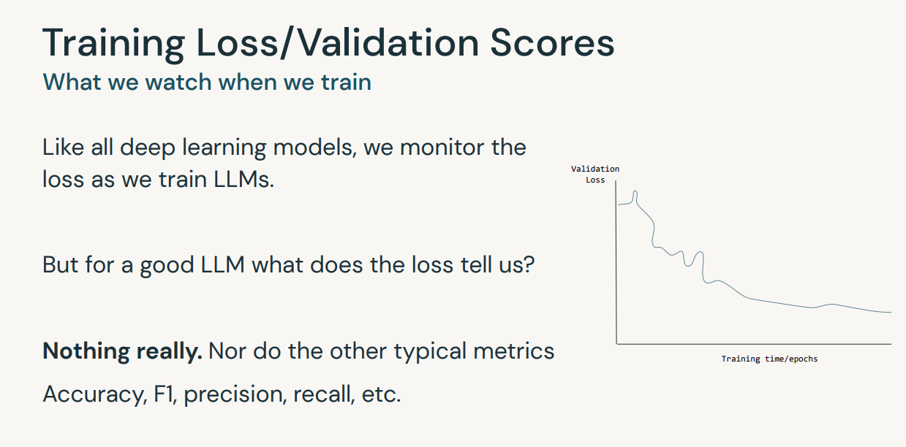

Slide 34
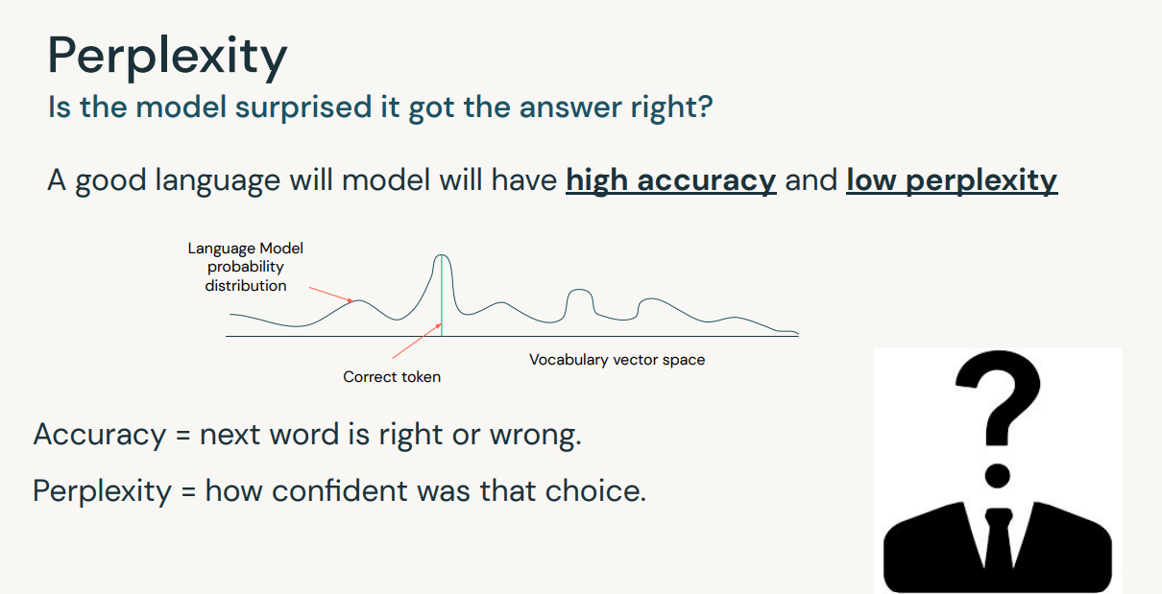

Slide 35
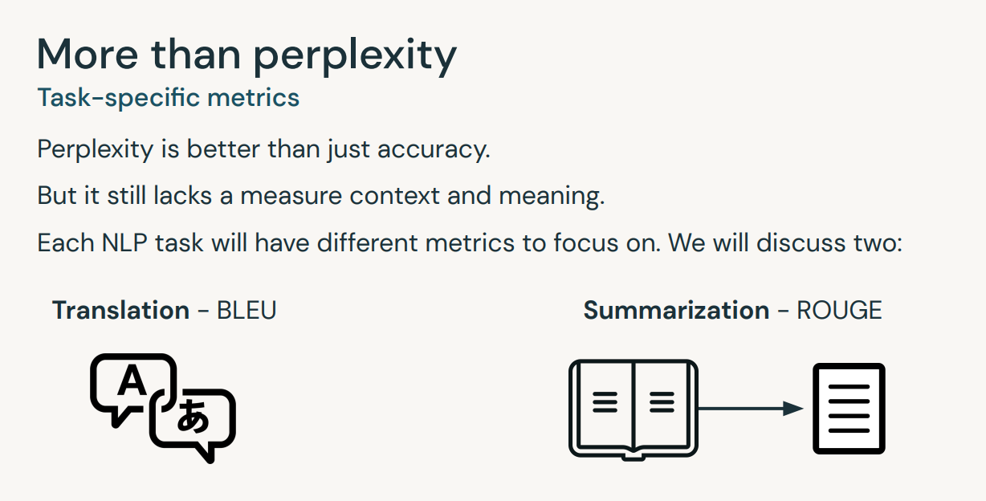

Slide 36
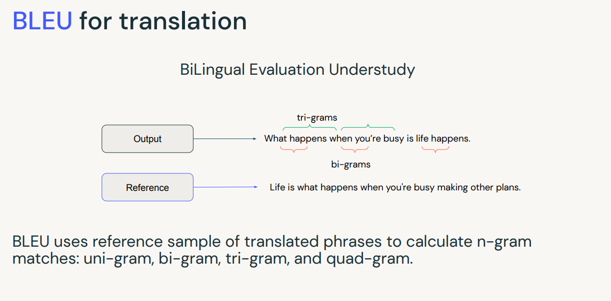

Slide 37
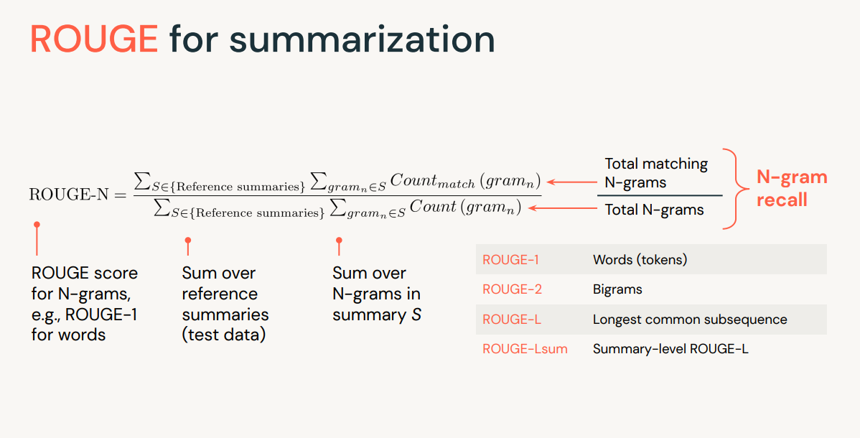

Slide 38
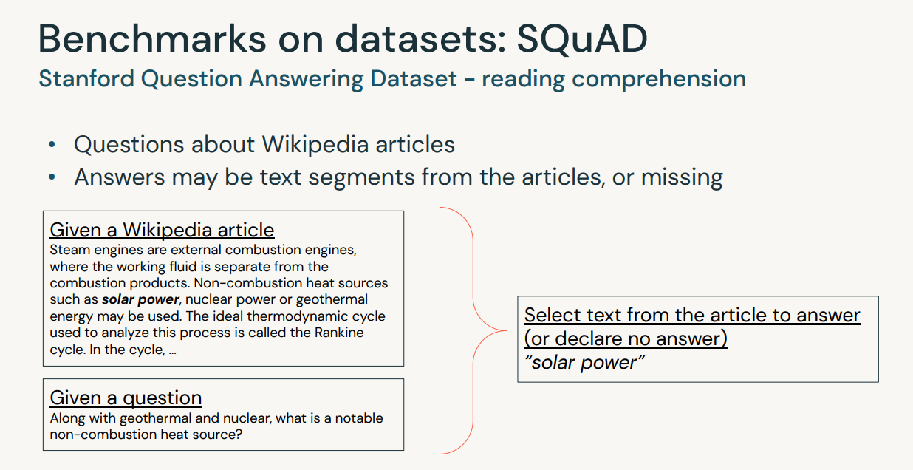

Slide 39
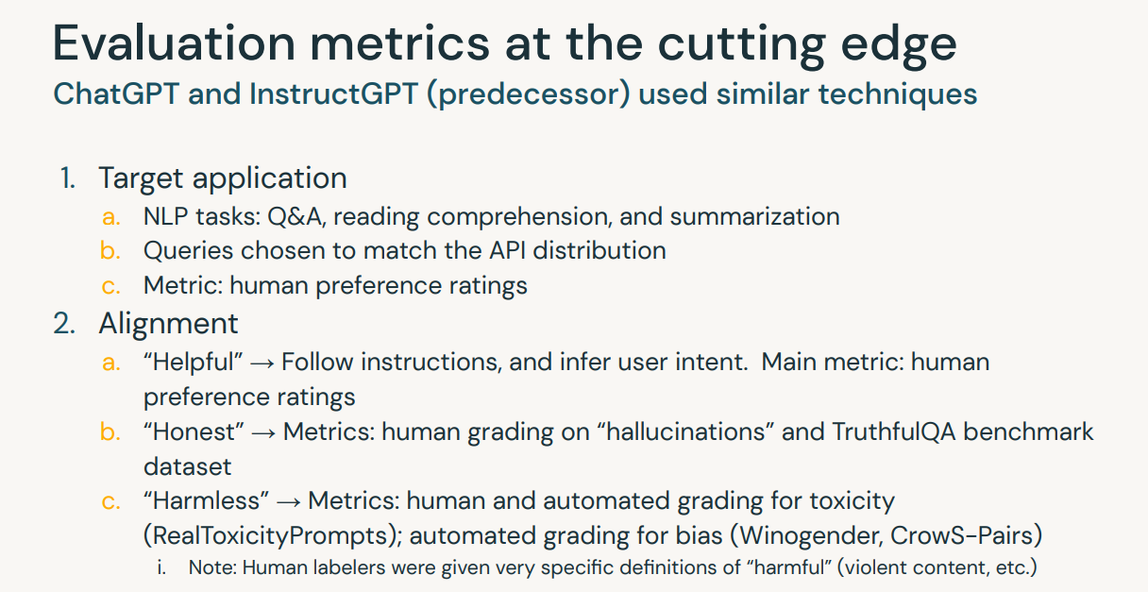

Slide 40
Refer: LLM 04a and 04b - Fine-tuning LLMs & Evaluation Notebooks for classification tasks, summarization tasks and related evaluation metrics

Slide 41
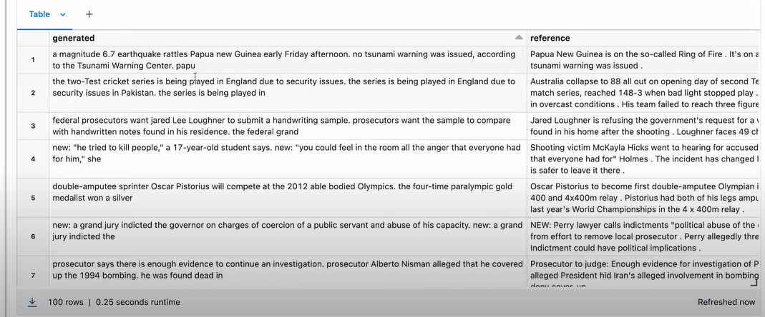
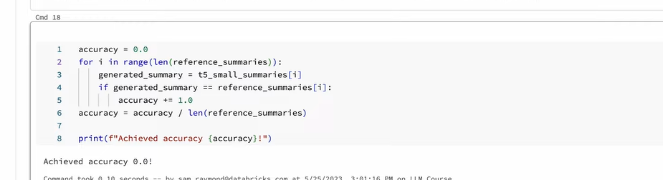
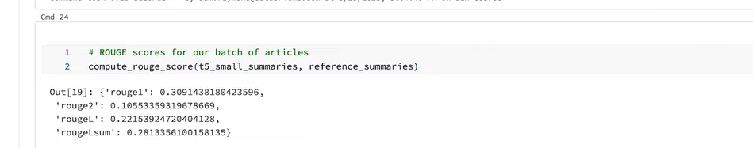
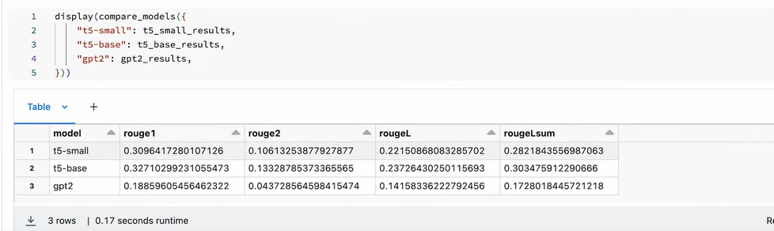
Results From Summarization Tasks
T5- small
T5 small vs T5-base vs GPT2

Slide 42
Ethical Evaluation

Slide 43
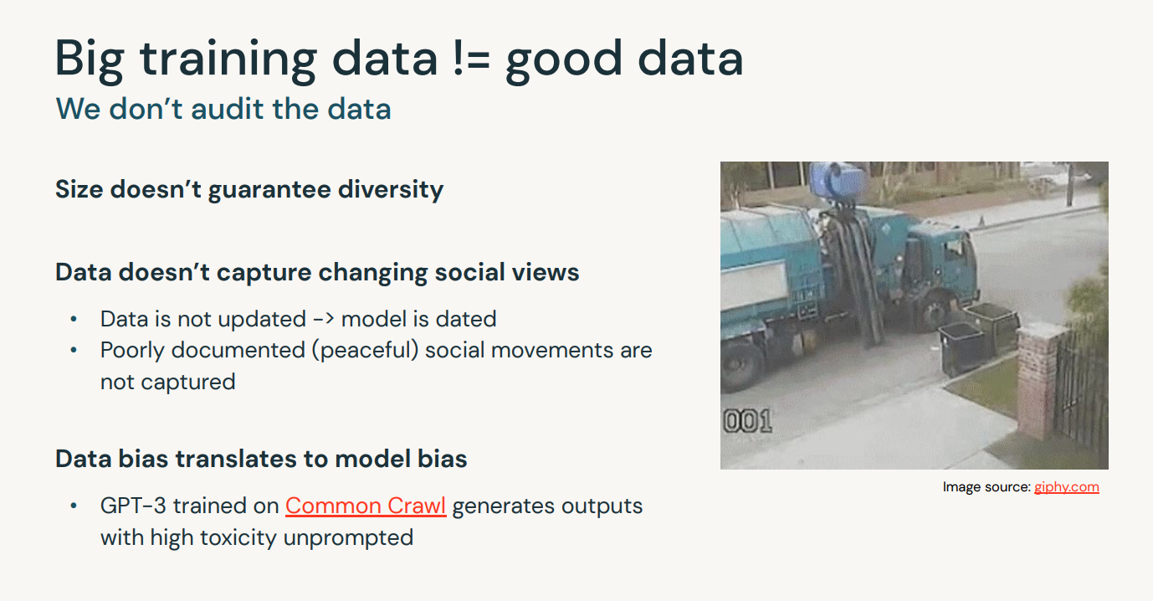
Risks & Limitations

Slide 44
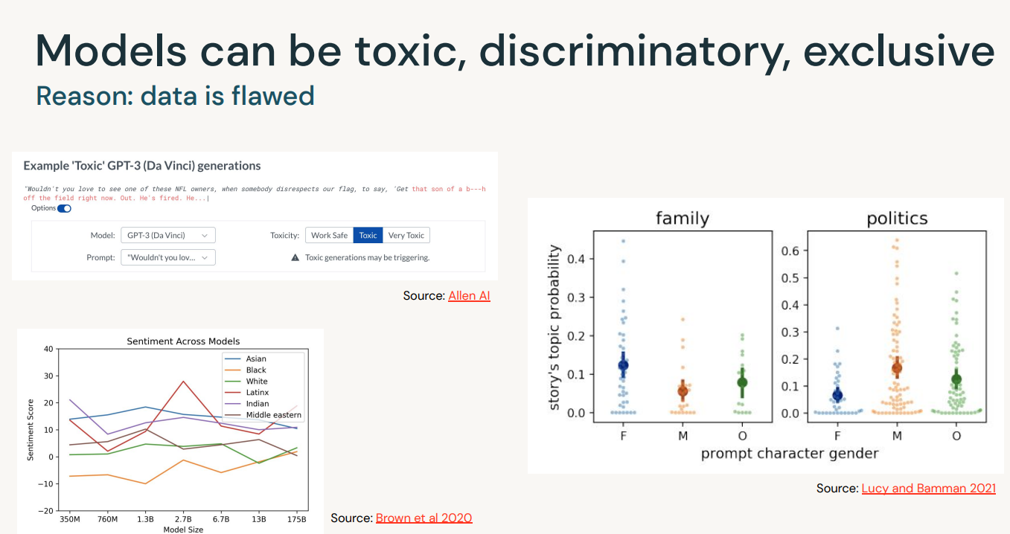
Risks & Limitations

Slide 45
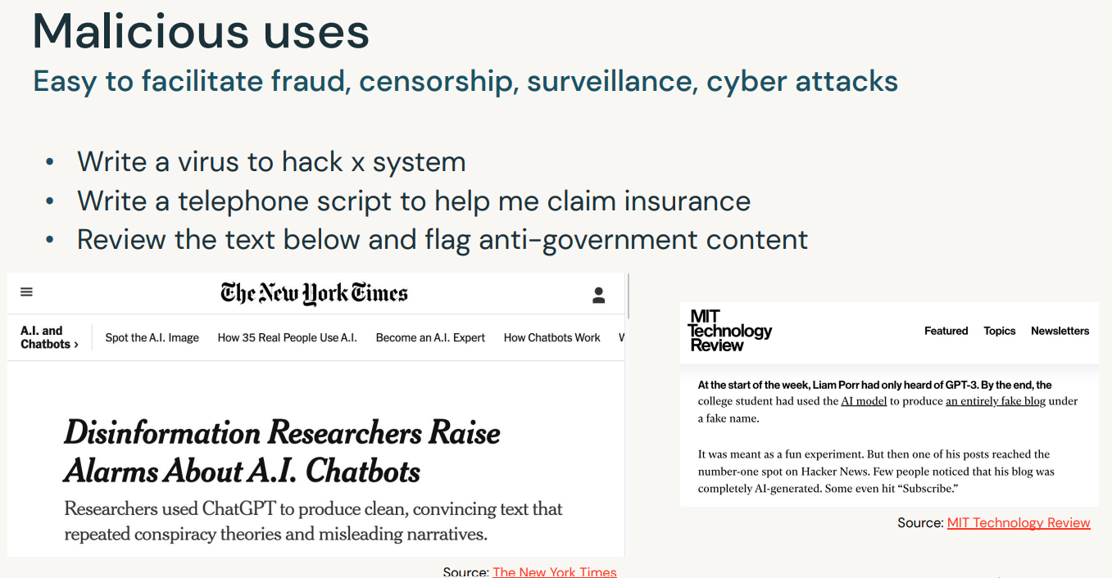
Risks & Limitations

Slide 46
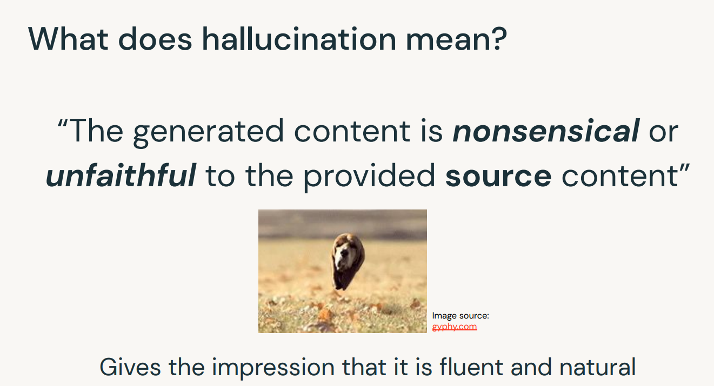
Risks & Limitations

Slide 47
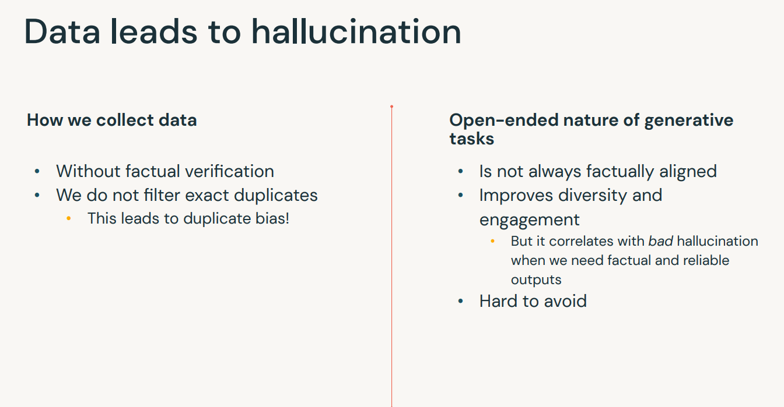
Hallucinations- Reasons & Mitigations

Slide 48
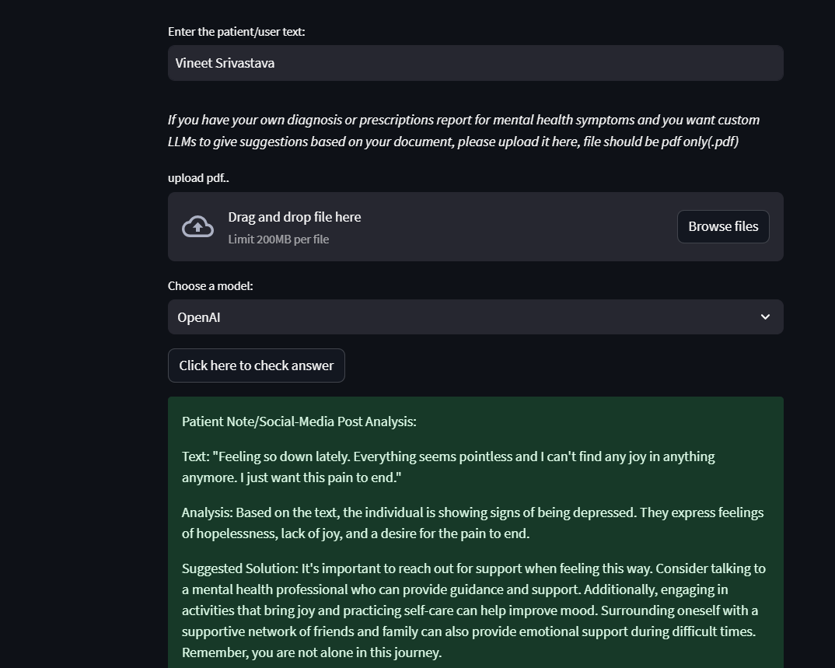
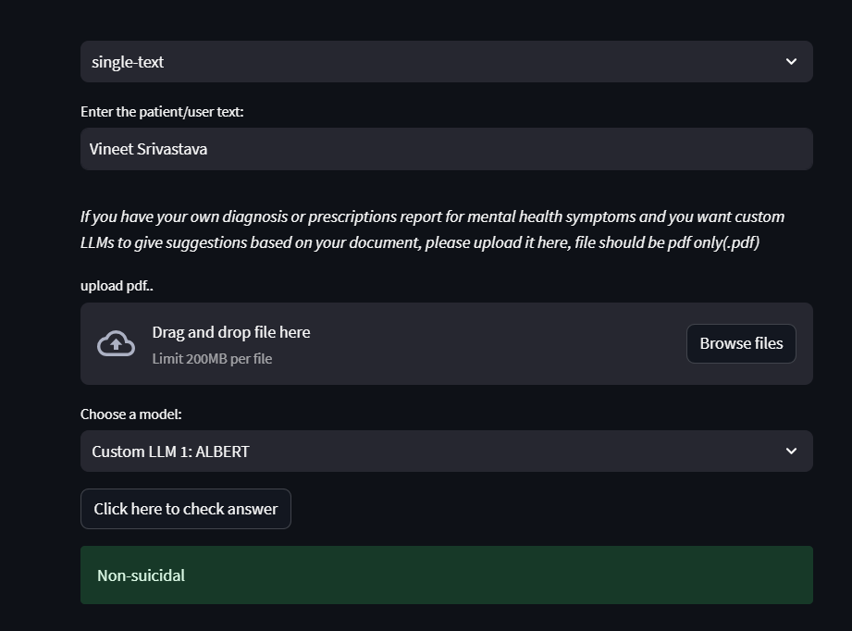
Hallucinations- Reasons & Mitigations
OpenAI- GPT3.5 Turbo Zero-Shot Classification for
mental disorders/depression detection
Fine-Tuning helps..!! (Fine-Tuned ALBERT)

Slide 49
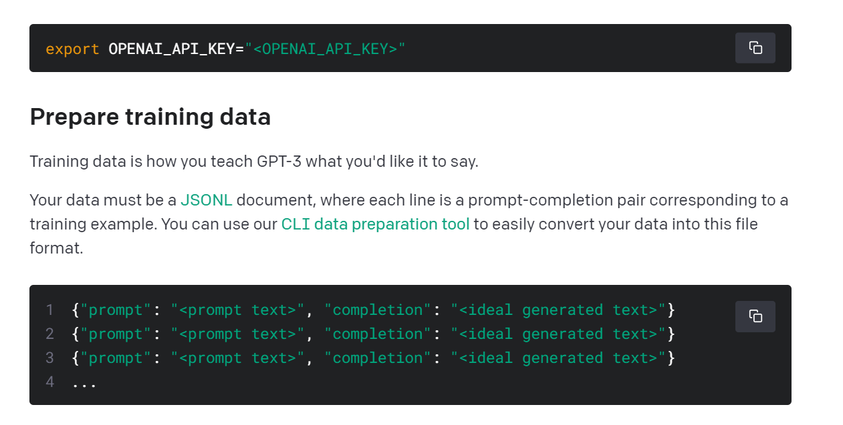
Hallucinations- Mitigations
How to solve OpenAI – GPT3.5 Turbo problem in previous slide?
Answer: Fine-Tuning (Alternative: Better prompts may help to address a situation but not always, can consider using LLM chains for multiple prompt instructions)
Fine-Tuning GPT3: https://platform.openai.com/docs/guides/fine-tuning
Choose hyperparameters like temperature (value from 0 to 1), a measure of creative context generation, carefully while querying the APIs

Slide 50
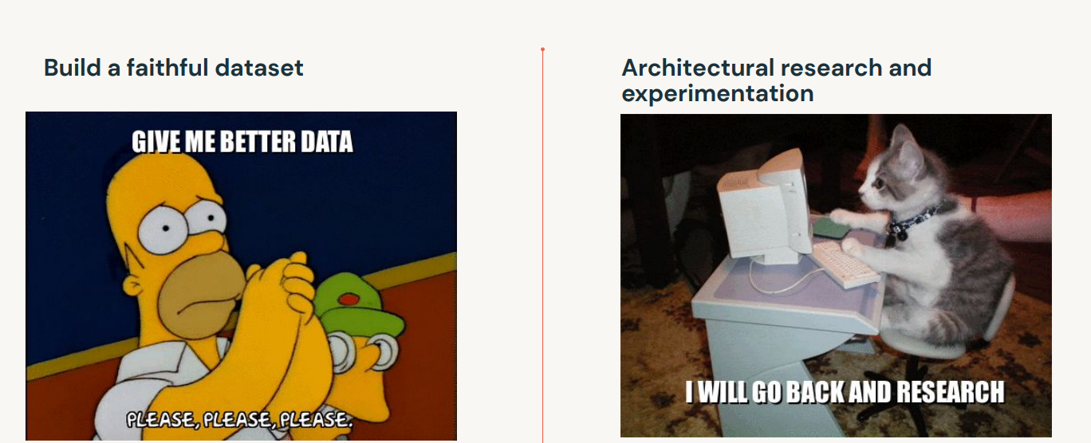
Hallucinations- Mitigations

Slide 51
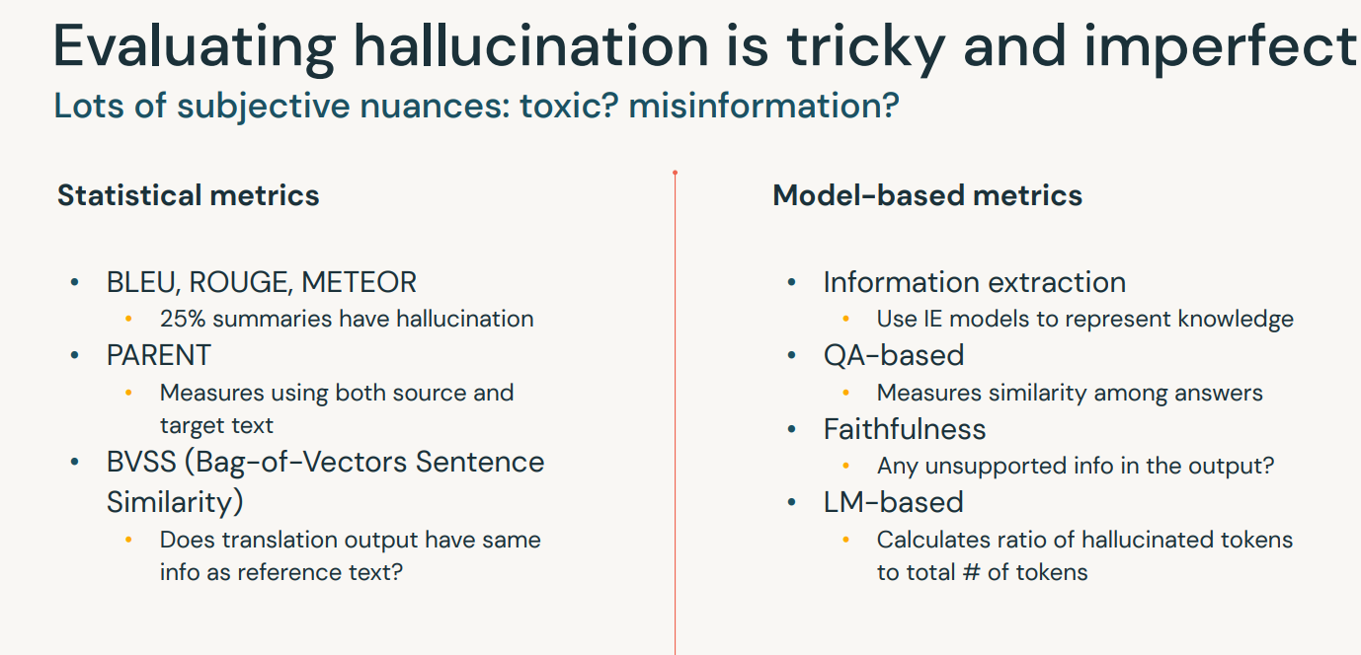
Hallucinations- Evaluation

Slide 52
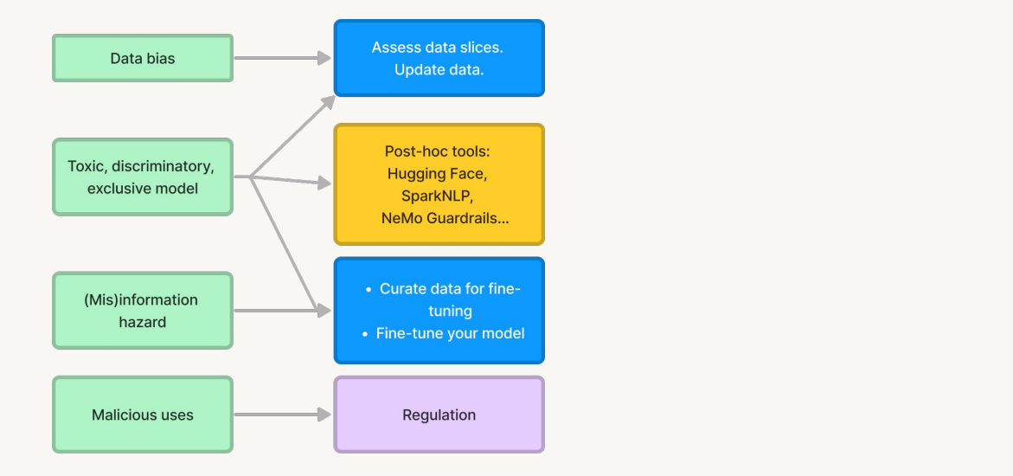
Risks & Limitation (General)- Mitigations
The guardrails are designed to promote
transparency, avoid deception, and mitigate
risks from improper use of NLP/speech models
RLHF

Slide 53
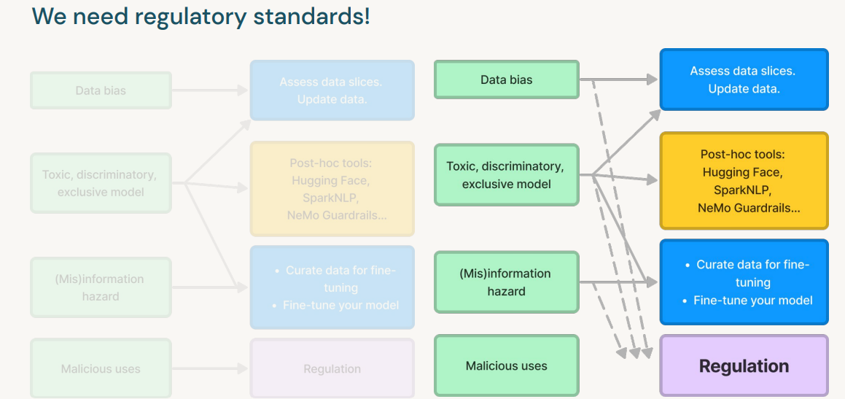
Risks & Limitation (General)- Mitigations

Slide 54
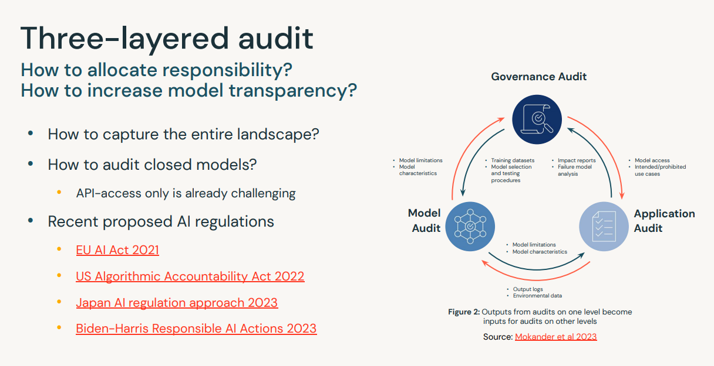
Risks & Limitation (General)- Mitigations

Slide 55
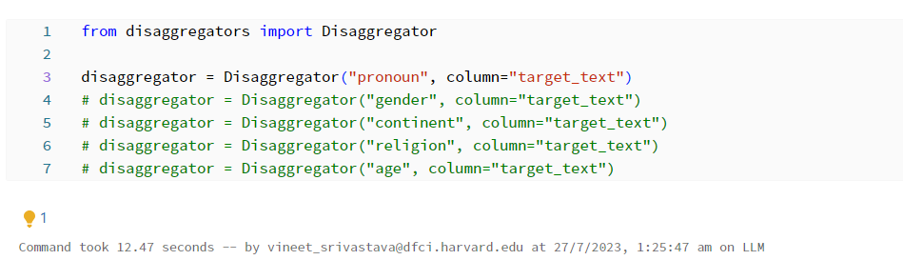
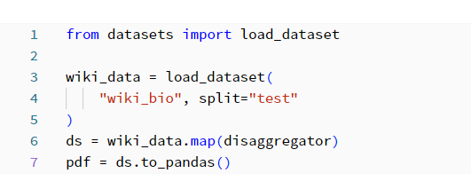

Tools to mitigate limitations and risks related to LLMs
Examining representation bias in dataset
Disaggregators is a library developed by Hugging Face. As the name implies, it "dis-aggregates" data so that we can explore the data in more granular detail and evaluate data bias.
There are multiple disaggregation modules available: age, gender, religion, continent, Pronoun
1
2
3
Refer: LLM 05 - LLMs and Society Notebook on databricks

Slide 56


Tools to mitigate limitations and risks related to LLMs
Examining toxicity in dataset (pre-trained BERT base example)

Slide 57


Tools to mitigate limitations and risks related to LLMs
Examining toxicity in dataset (tools)
Now that we have inspected data and model bias above, let's evaluate the toxicity of language model outputs.
To do this, we leverage another Hugging Face library called evaluate.
The evaluate library can measure language models from different angles:
Toxicity: how problematic the completion is, such as hate speech
It uses Facebook's roberta-hate-speech-dynabench-r4-target model behind the scene to compute toxicity.
HONEST: Another Hugging Face tool to determine how hurtful the completion is
The model was published in 2021.
It replaces certain words with [MASK] and evaluates the hurtfulness based on what the language models generates output.
Regard (by Anthropic): whether the completion regards a certain group higher than the others
"Privacy is of paramount importance when dealing with such tools, especially concerning sensitive healthcare information like PHI. Proper steps need to be taken when using these tools, such as Data Governance, Audits, using synthetic datasets instead of original data, adding Noise, etc."

Slide 58




Tools to mitigate limitations and risks related to LLMs
Contrastive Explanation using SHAP
Yin and Neubig 2022
Output (from GPT2): barking
“lm_saliency” python module

Slide 59
LLMOPs

Slide 60

Objectives

Slide 61


Slide 62


Slide 63


Slide 64


Slide 65


Slide 66


Slide 67


Slide 68


Slide 69


Slide 70


Slide 71


Slide 72


Slide 73


Slide 74


Slide 75

Orchestration of LLMOPs Pipelines- Delta Live Tables (DLT)

Slide 76


Orchestration of model inference Pipelines- Delta Live Tables (DLT)

Slide 77
Observations- DLT pipelines

Slide 78
Thank You..!!

